Slide 1
Project 4 SEAS 8515 for Dr. Adewale Akinfaderin by Michael Wacey

Slide 2
Plan
Project 4
Use the data provided and follow the steps laid out in the assignment.
Use the Community Edition account in Databricks that I have set up.
Use the material from the book and class to complete the steps.

Slide 3
Documentation
The data set provided is large and has a considerable number of features
Initially I planned to look at all the features and pare it down based on what I found.
However, the processes I had could not run in the one hour time limit with all of the features
So, instead I started with a small set and built them up as I progressed.
This resulted in four steps of adding features to the set.

Slide 4
Report - Part 1
I spend considerable time on this part.
At first I was using most of the features but execution would take longer than one hour and so it failed.
Then I dropped back and started with a small set of features
As I answered each question, I added more features.
In the code you can see them marked as Set 1, Set 2, Set 3, and Set 4.
By the time I got to Set 1-4, it was taking about 10 minutes to run

Slide 5
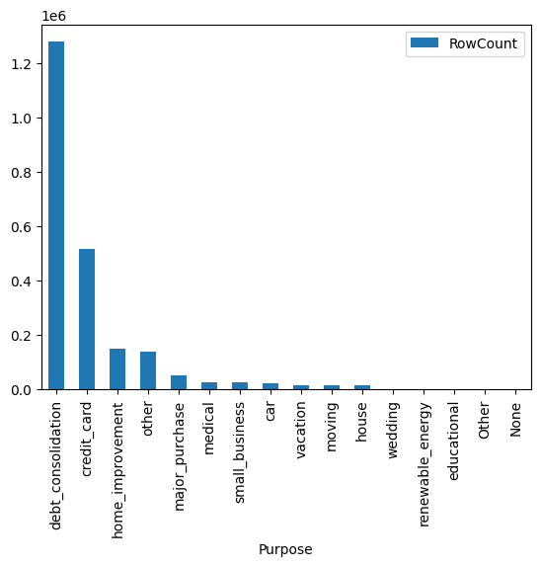
Report – Part 1
Question 1 – 4 gave me insight into the data.
This graph is from question 1 and shows that most of the loans are for debt consolidation.

Slide 6
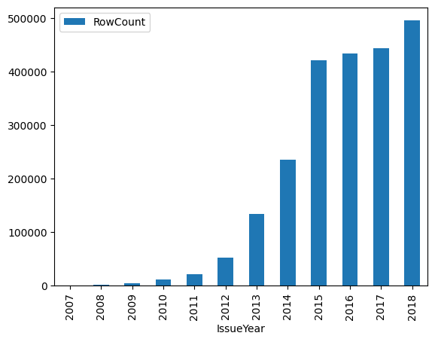
Report – Part 1
In question 2 we can see that the number of loan originations grew quickly over time.

Slide 7
Report – Part 1
Question 3 showed me that the there is only one row per loan. At this point, I was concerned that the data may have multiple rows per loan.
Question 4 showed me that that there were many delinquencies in the data.

Slide 8
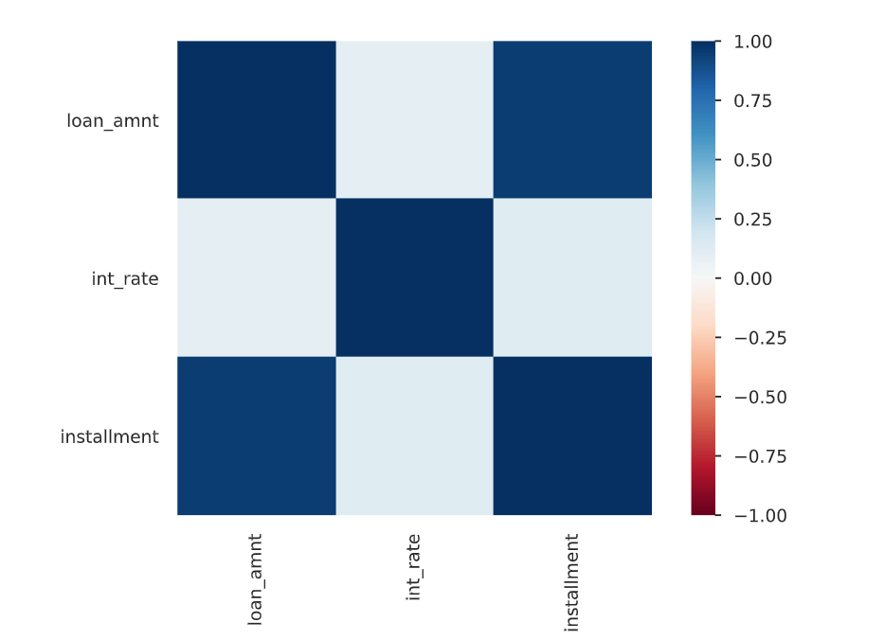
Report – Part 2
Much of part 2 was done duing part 1.
I ran a y-profile that showed the highly correlated data
Clearly, loan amount and installment amount would be highly correlated
Because I reduced the set of features for analysis, I naturally took out data with high correlation.

Slide 9
Part 3 - Report
I was unable to get any models to run
I used the approach from th book and kept getting into issues with numeric values, features already in the data, and numerous other issues.
Searching the web would solve one problem but then introduce another.
I have no idea why this data set caused me so much trouble.
Based on my experience, I expected the FICO scores to be the best indicator of Loan Status. The FICO score has been developed over the years for this exact purpose.

Slide 10
Part 3 - Report
Discuss any model governance and relevant quality checks that should be implemented before using machine learning for this dataset.
I would prefer to see multiple files rather than one combined file
That is, a Member File, a Member History File, a Loan File, and a Payment History File
This combined file was missing detail of payments that could be useful
The Member History file could show changes over time and the impact on loan status. For example, if a members FICO score is going down, that would indicate a greater likelihood of late payments or default.

Slide 11
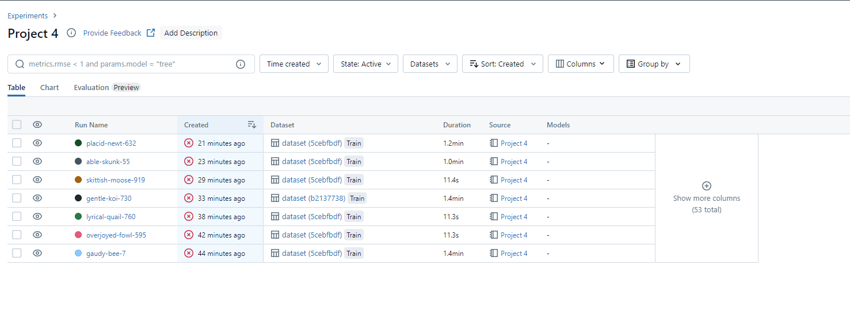
Part 4

Slide 12
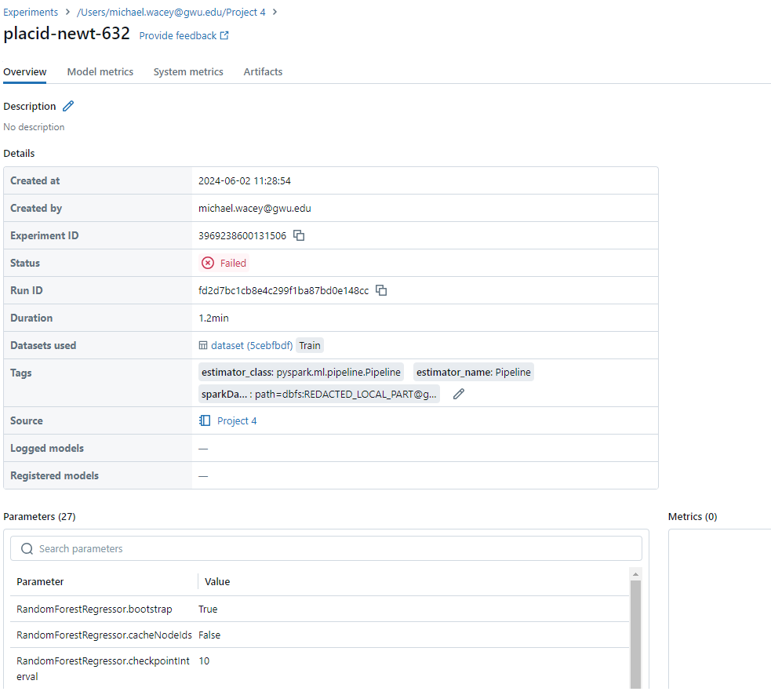
Part 4

Slide 13
Thank You

